Slide 1
METAVERSE
PARALLEL UNIVERSE

Slide 2
AGENDA
1
INTRODUCTION
2
VIRTUAL MEDIA AND XR TECHNOLOGIES
3
METAVERSE DEVELOPMENT
4
CRYPTO CURRENCY
5
REAL WORLD USES

Slide 3
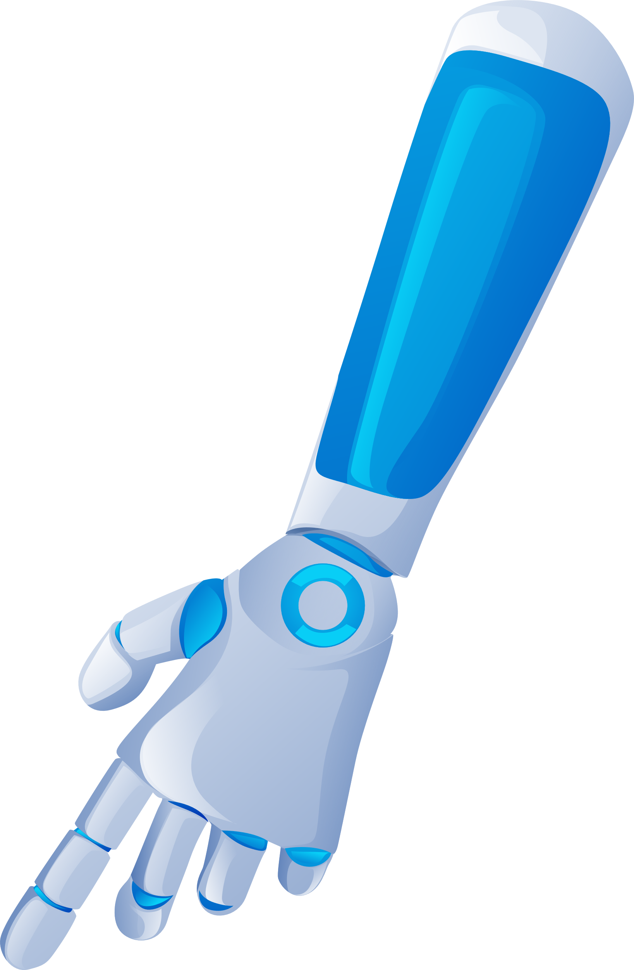

VIRTUAL MEDIA AND XR TECHNOLOGIES
VIRTUAL HUMAN BRAIN
VR usually brings to mind futuristic science fiction images and sophisticated hardware.
Notes:
https://pixabay.com/photos/architecture-building-amsterdam-1448221/

Slide 4

NON FUNGIBLE TOKENS(NFTs)
Non-Interchangeable Unit
Bored Ape Yacht Club is a NFT Product Collections which has worth of $2,307,638

Slide 5
METAVERSE TIMELINE
400K
META-DEVELOPMENT
Metaverse was developing vast from 1990 to till now and it was developed in many categories of development
300K
250K
200K
100K
1990
2000
2015
2020
2022

Slide 6
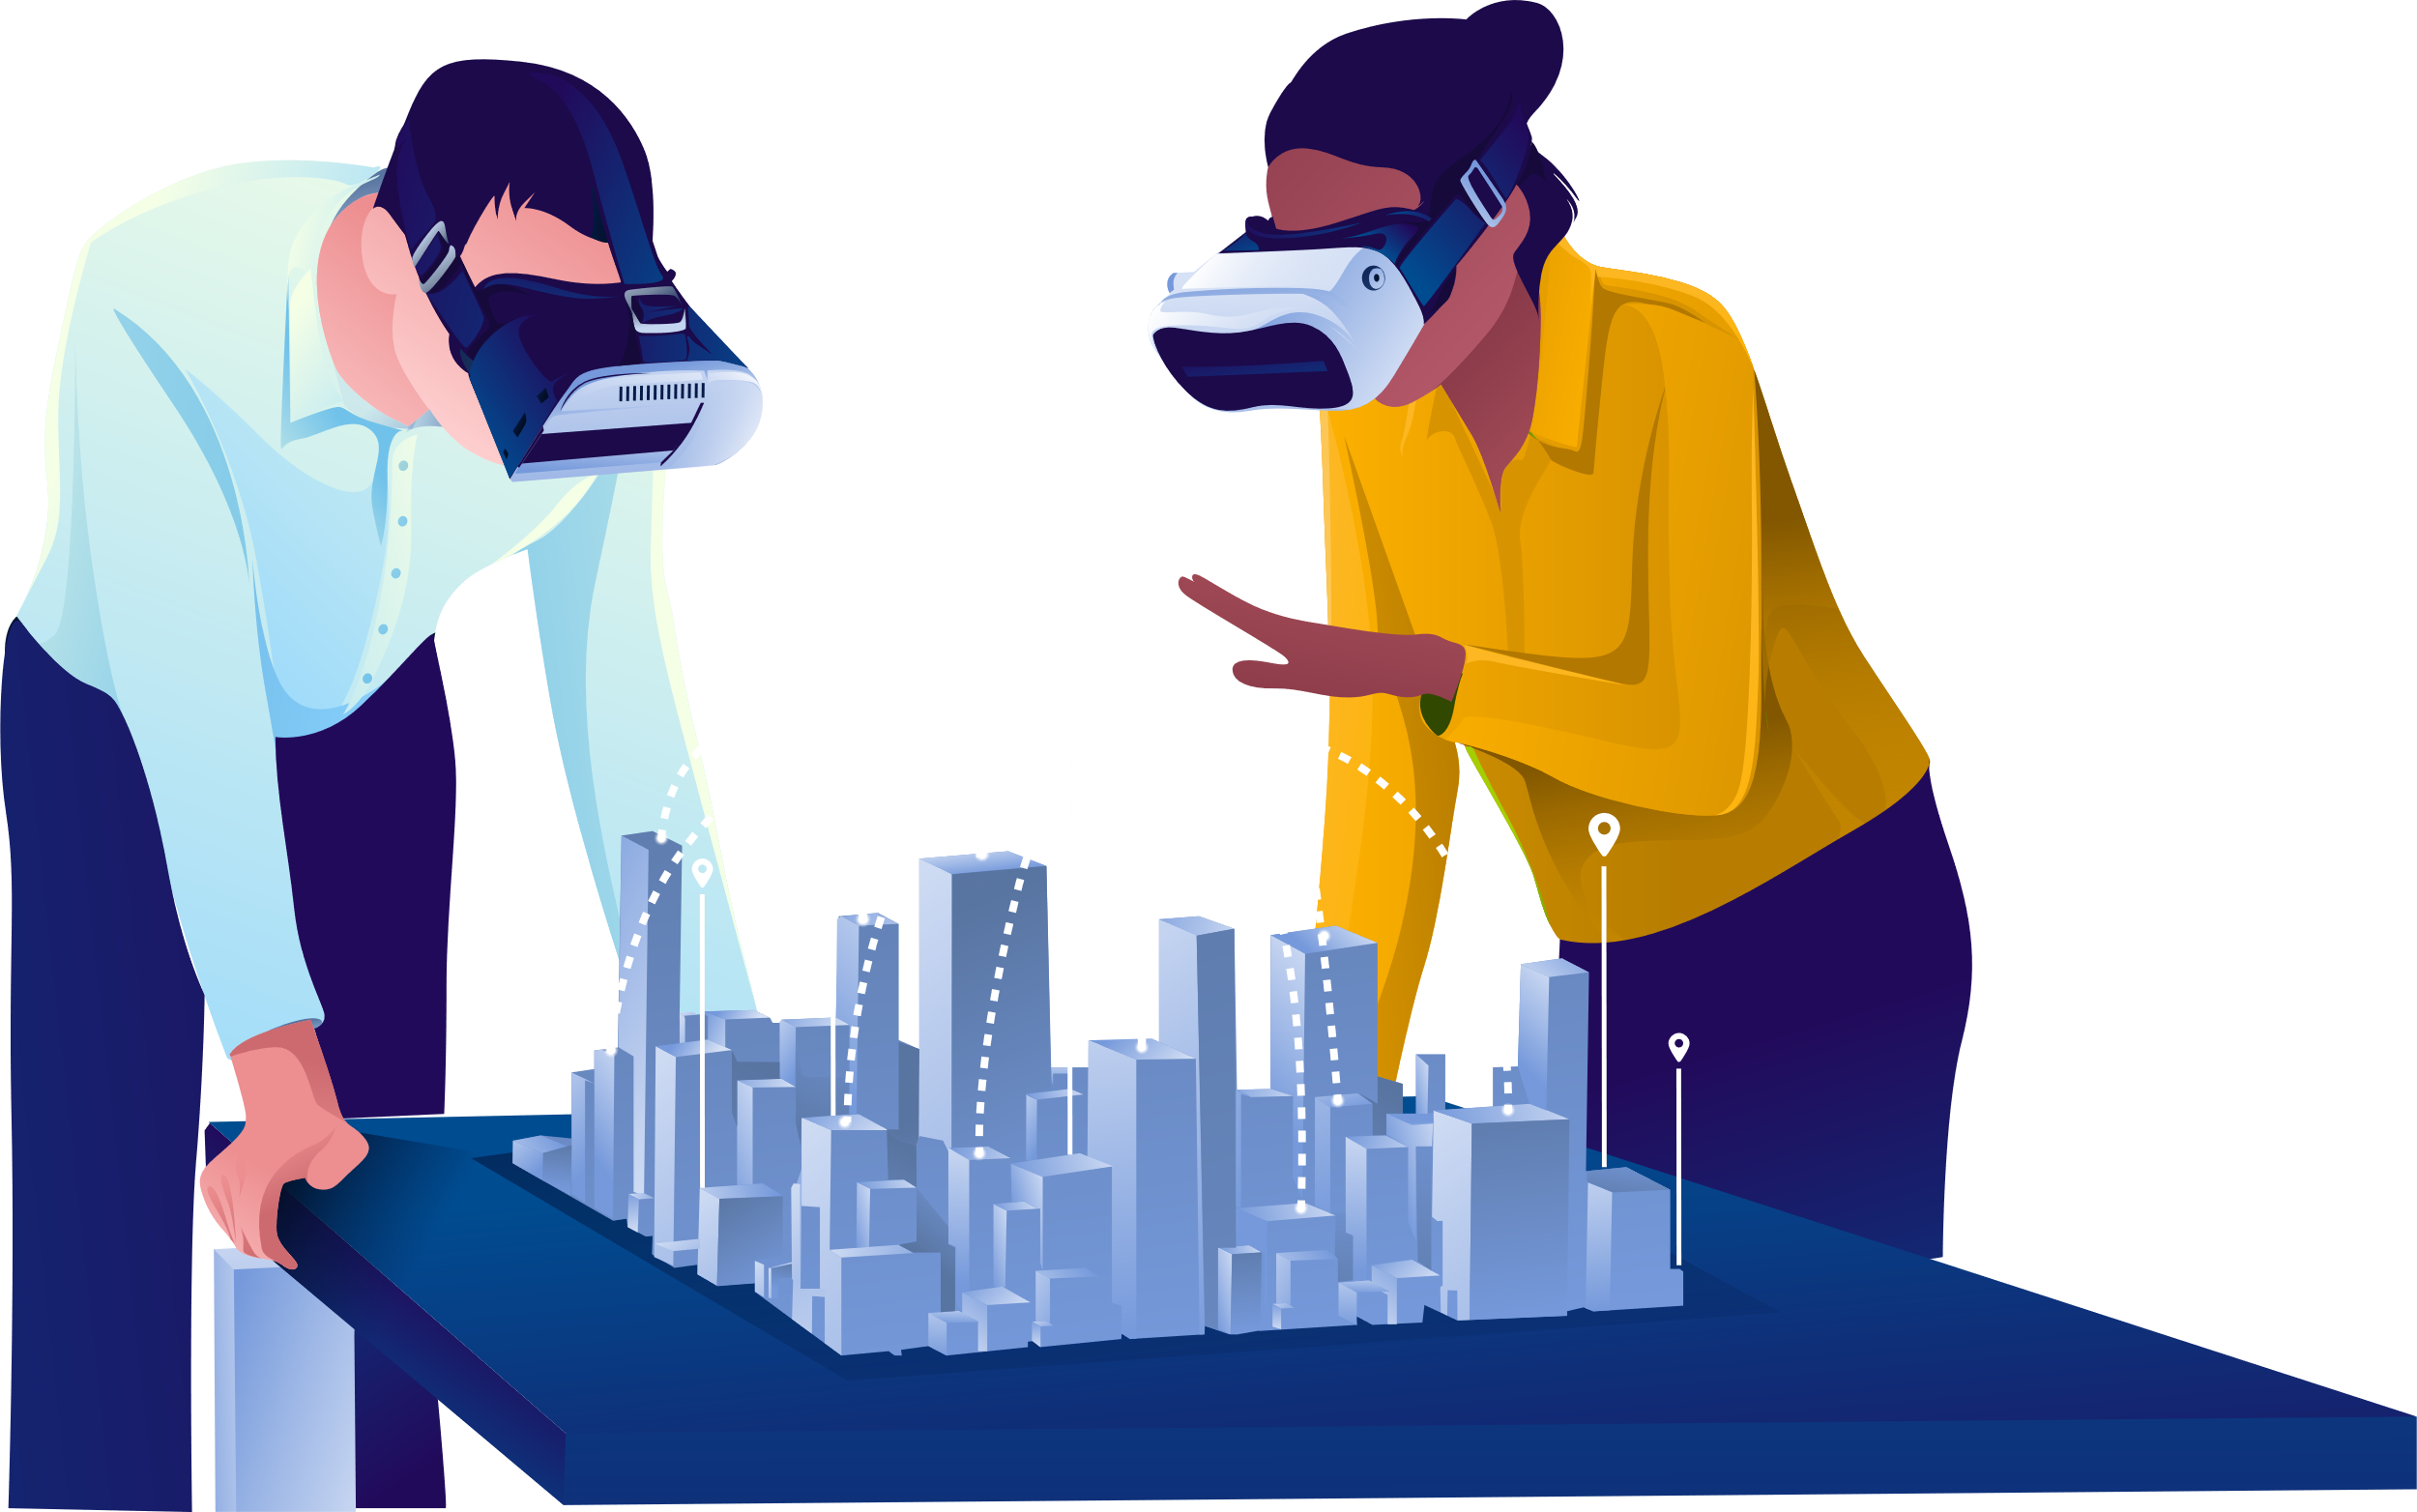
META-EDUCATION
Metaverse can enable immersive journalism to accurately and objectively educate mass audiences on unfamiliar circumstances and events in remote locations.

Slide 7
ADVANTAGES OF METAVERSE
Immersive Experience
Creating New Character
Improvement To Gaming
New Business Opportunities
Improvement To Work Environment

Slide 8
EXAMPLES OF METAVERSE SYSTEM
Fortnite
Horizon
Virtual Reality Game
NFT Platform
01
03
01
01
05
01
02
04
Ready Player 1
IMVU
Second Life
Movie Based On Metaverse
Virtual Social Media Platform
Virtual World

Slide 9

CRYPTO CURRENCY IN METAVERSE
Digital Asset
AXIE Infinity is the biggest Metaverse cryptocurrency that has reached 3 million players on the platform

Slide 10

MARRIAGE IN
METAVERSE
Destination For Weddings
Due to COVID – 19 Pandemic, Dinesh SP and Nandhini Couple got married on February - 6 in Tamil Nadu Through Metaverse Blockchain System.

Slide 11




DIS-ADVANTAGES OF METAVERSE
5G Wireless Network
Metaverse Leads To Privacy Threat
Animation Quality
People Leave In Actual World

Slide 12
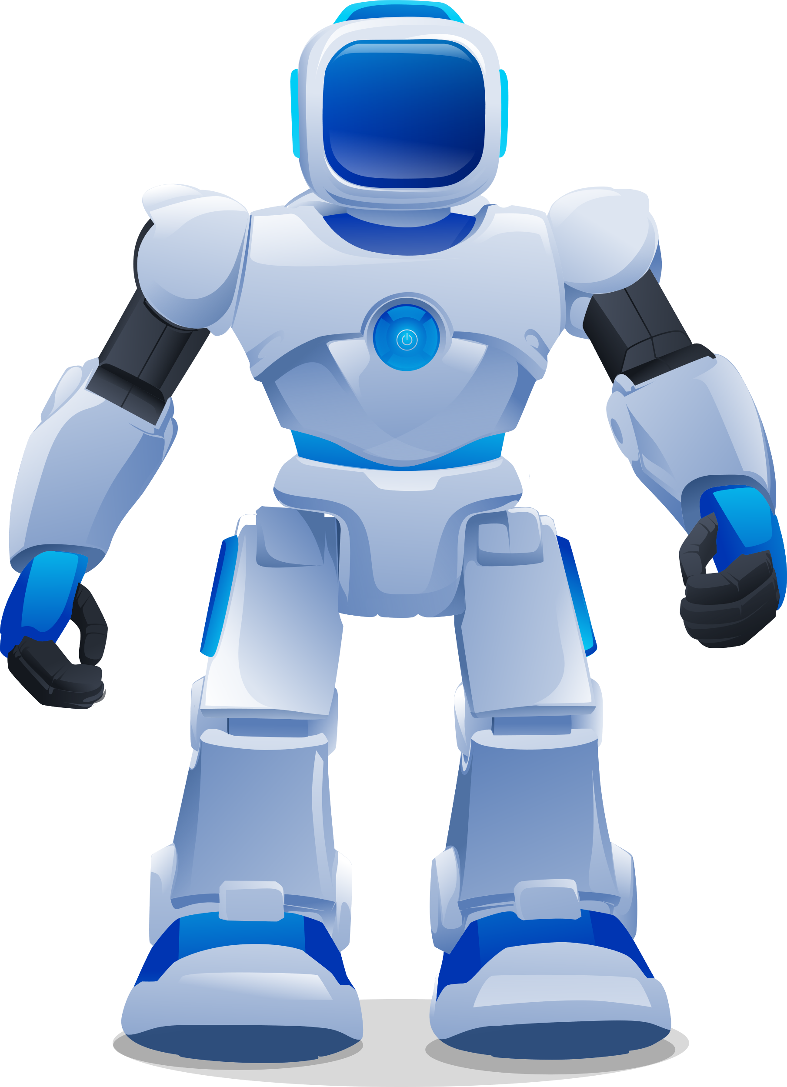
CONCLUSION
End Of Presentation
Meta aims to build on that experience by becoming fully three-dimensional and multisensory.

Slide 13

“TECHNOLOGY, LIKE ART, IS A SOARING EXERCISE OF THE HUMAN IMAGINATION.”
- Daniel Bell

